Slide 1
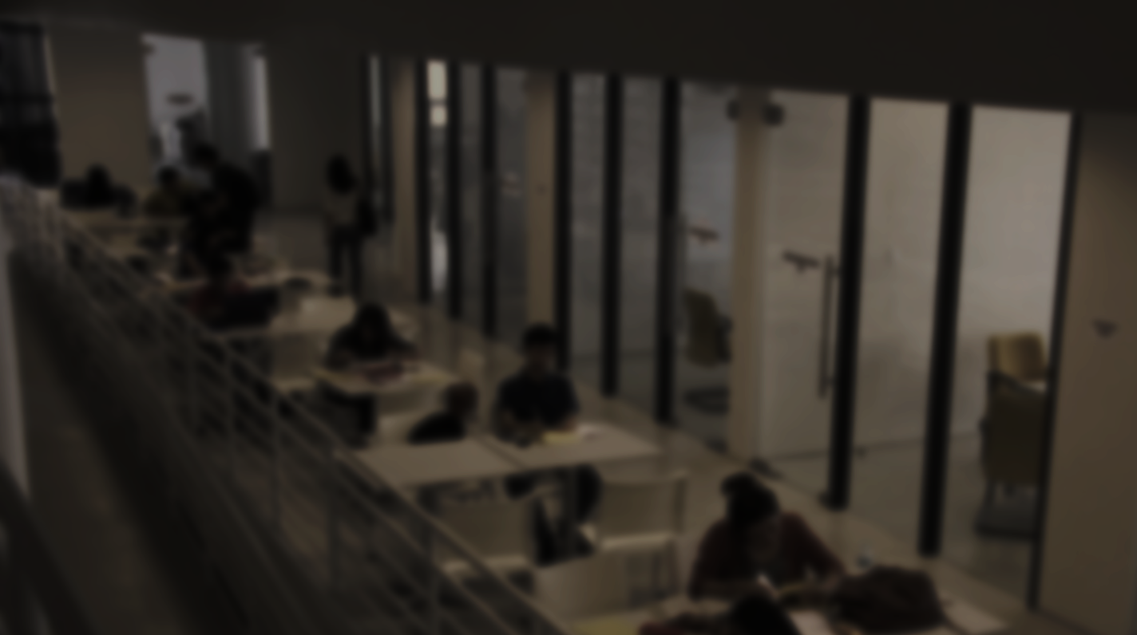
creative
Native
Laurenz Tolentino
.

Slide 2
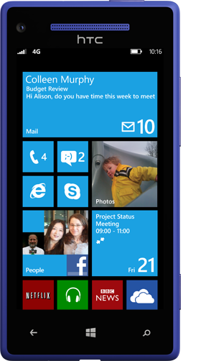
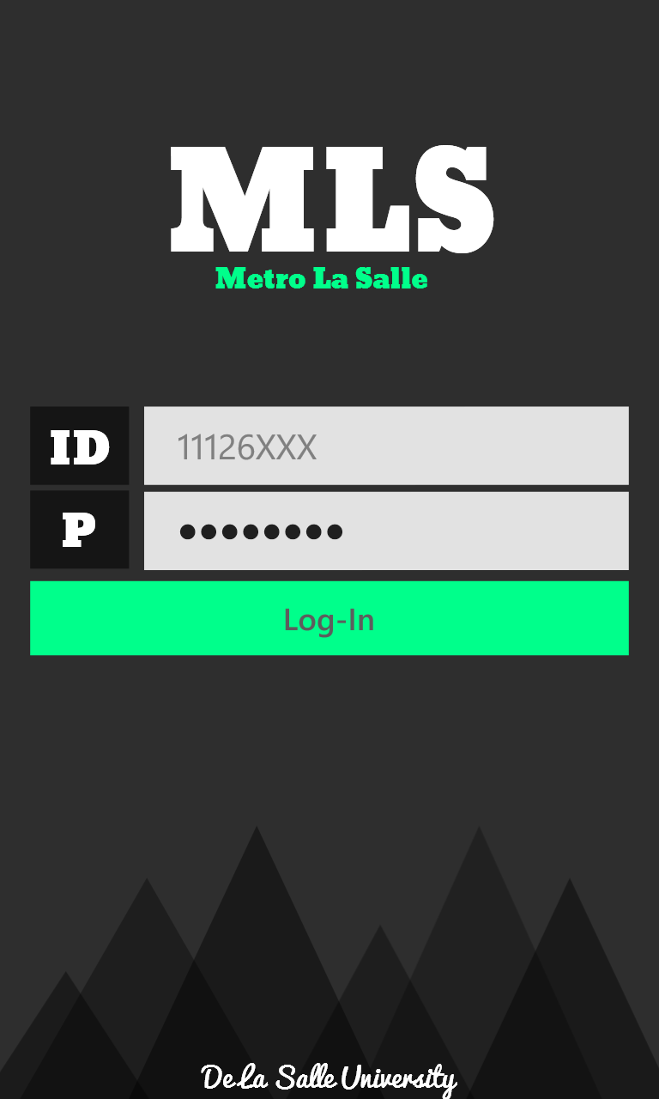
De La Salle University
Portal App
Metro
LaSalle

Slide 3
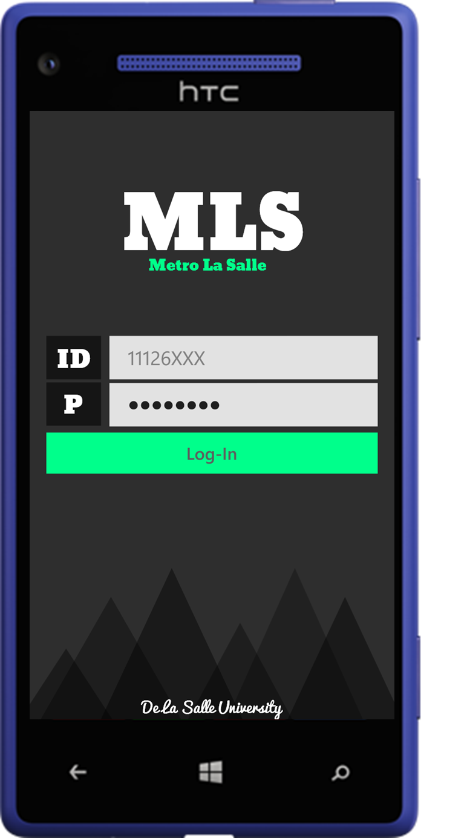


Metro La Salle
Student Partner App for Lasallians
Coming Soon
SevenStates
Laurenz Tolentino
Franz Buenaventura

Slide 4
LAURENZ
TOLENTINO

Slide 5
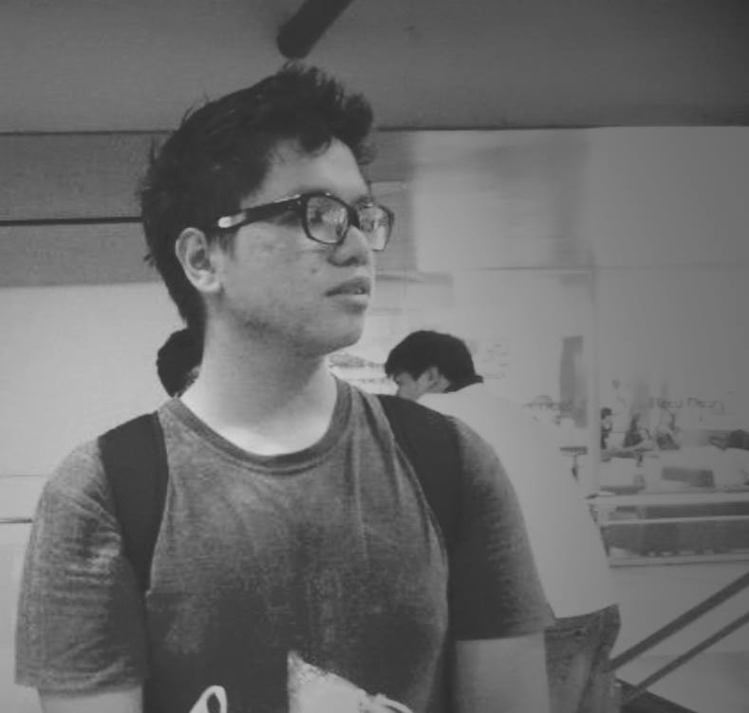
TOLENTINO
20
LAURENZ
TOLENTINO

Slide 6
MSP
La Salle
Computer
Student
Netcentric
Governments
Society

Slide 7
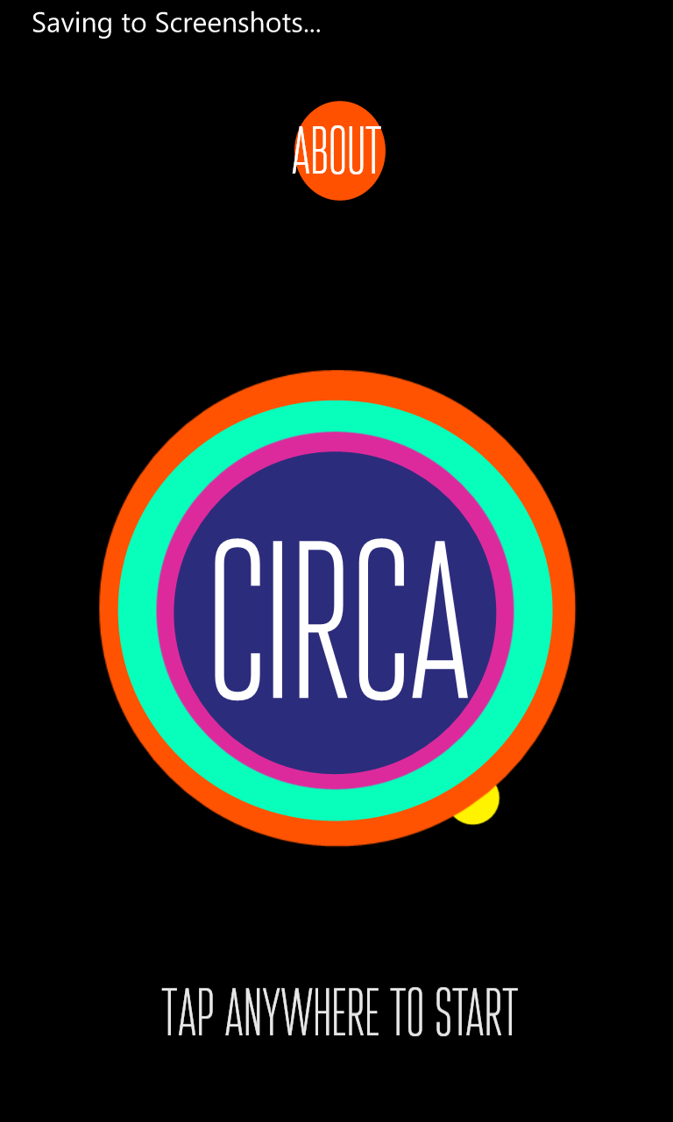
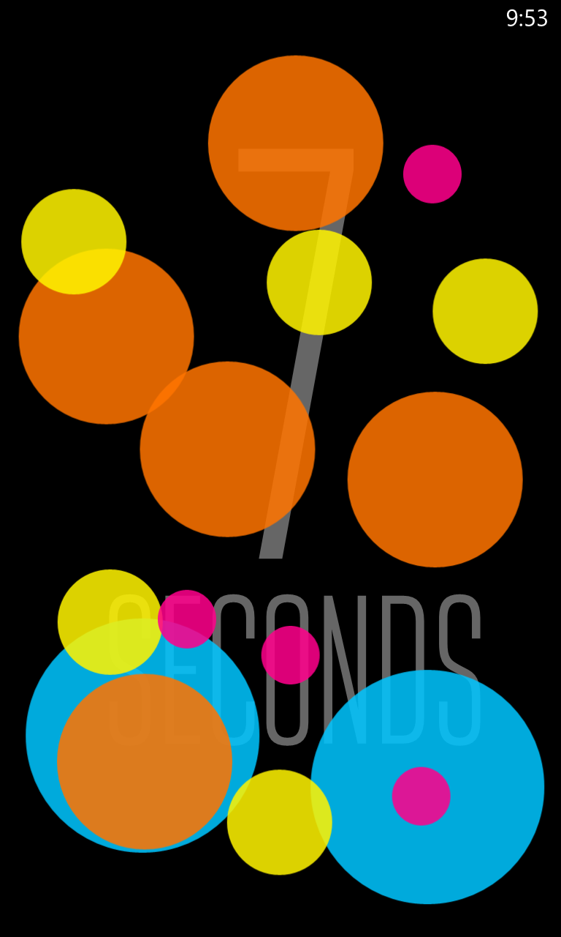

12:38
12:38

Slide 8
12:38

Slide 9
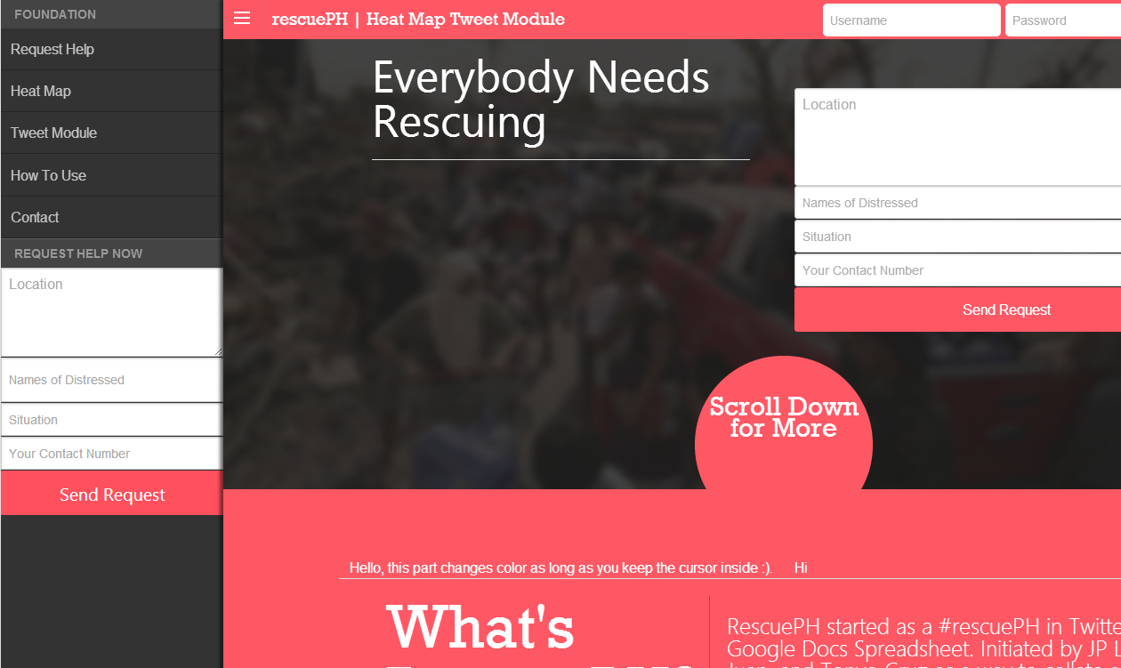
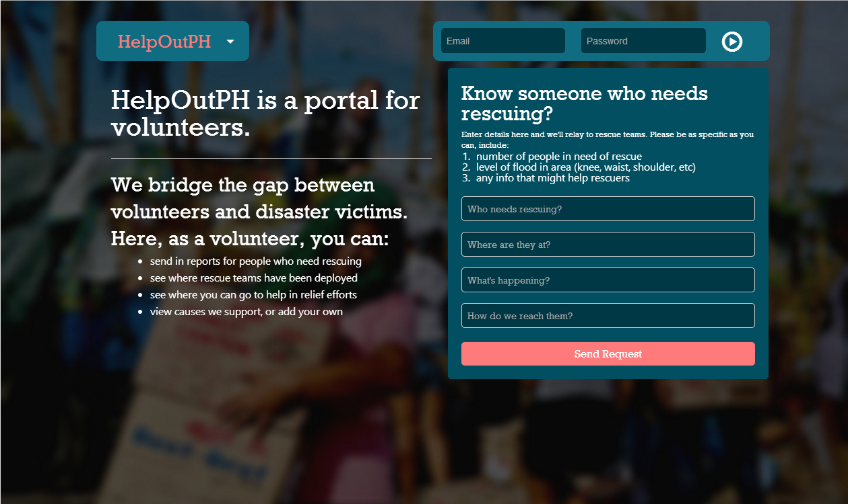

Slide 10
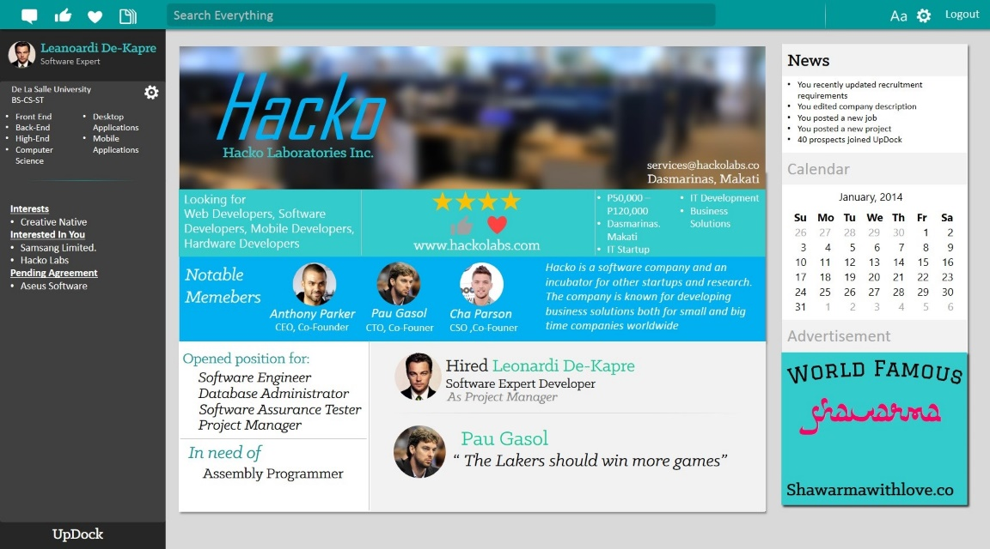
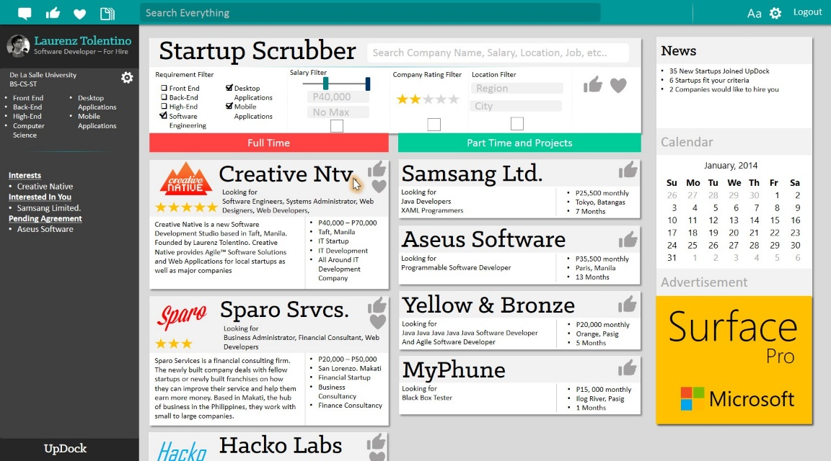
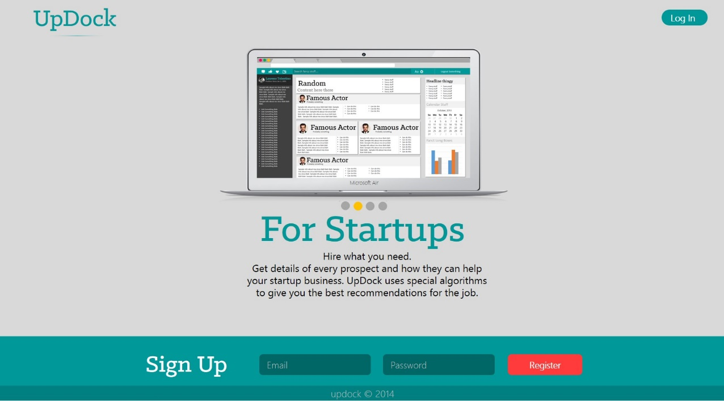

Slide 11
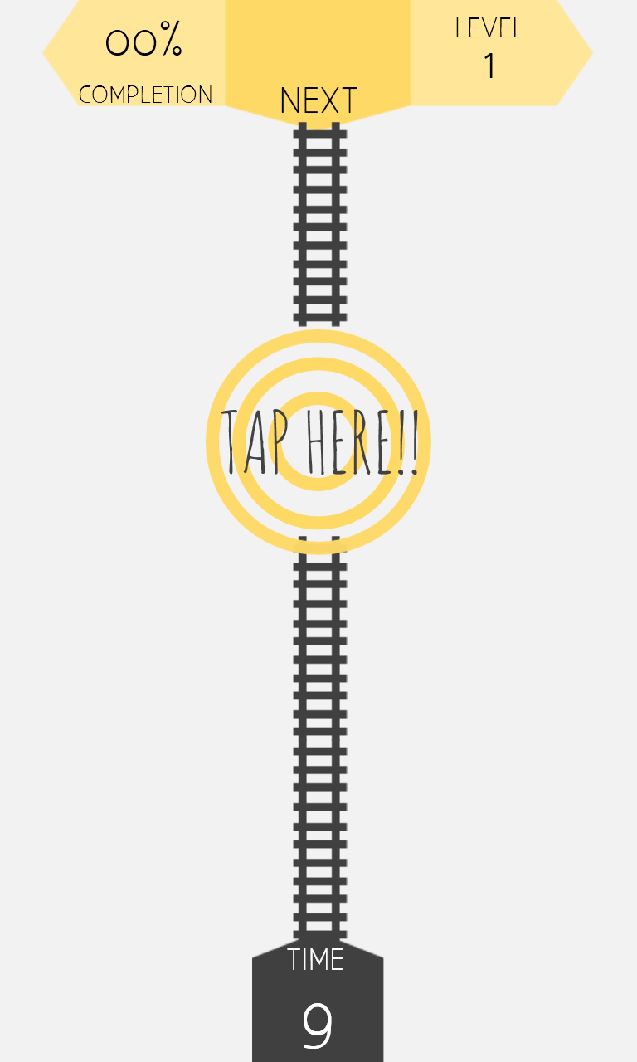

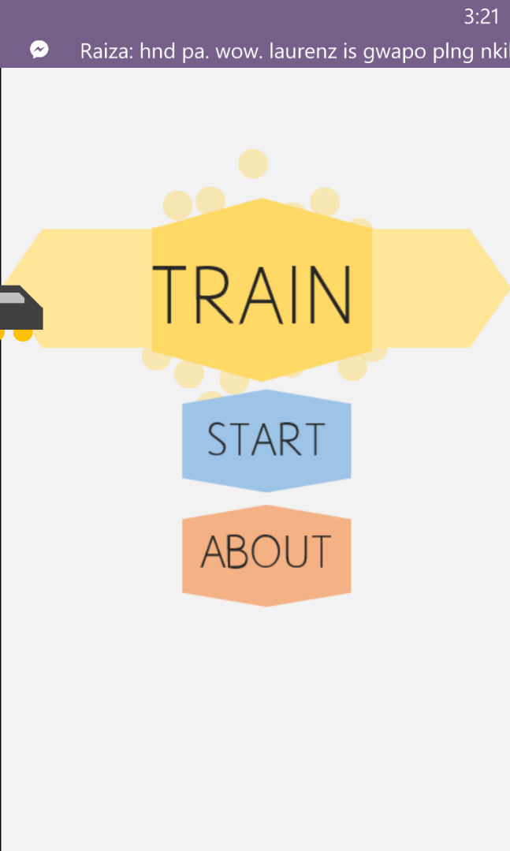
12:38
12:38
12:38

Slide 12
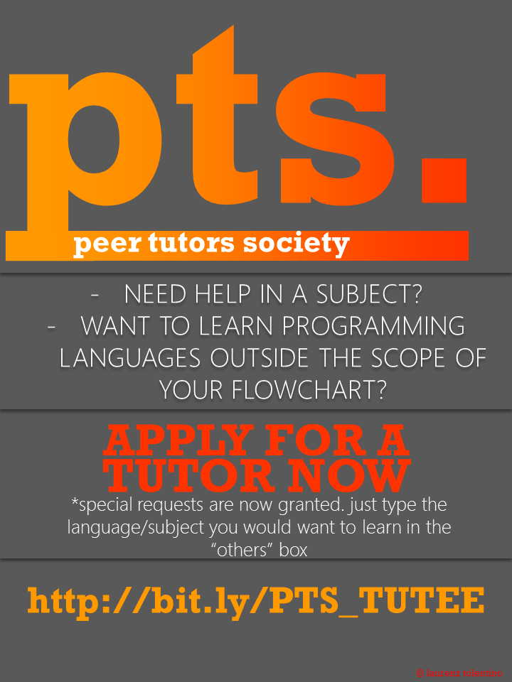
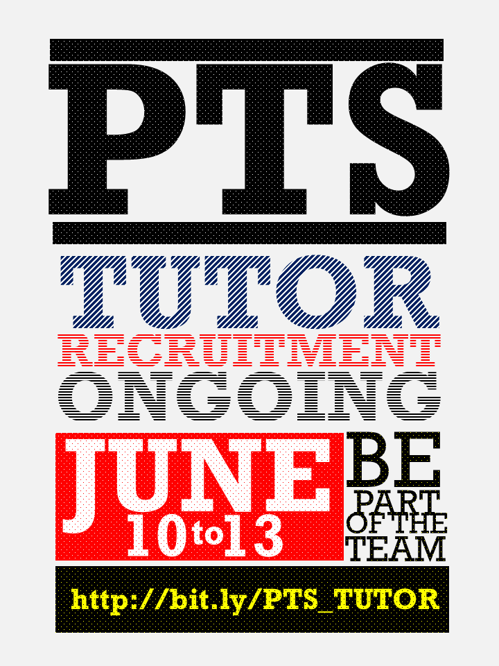

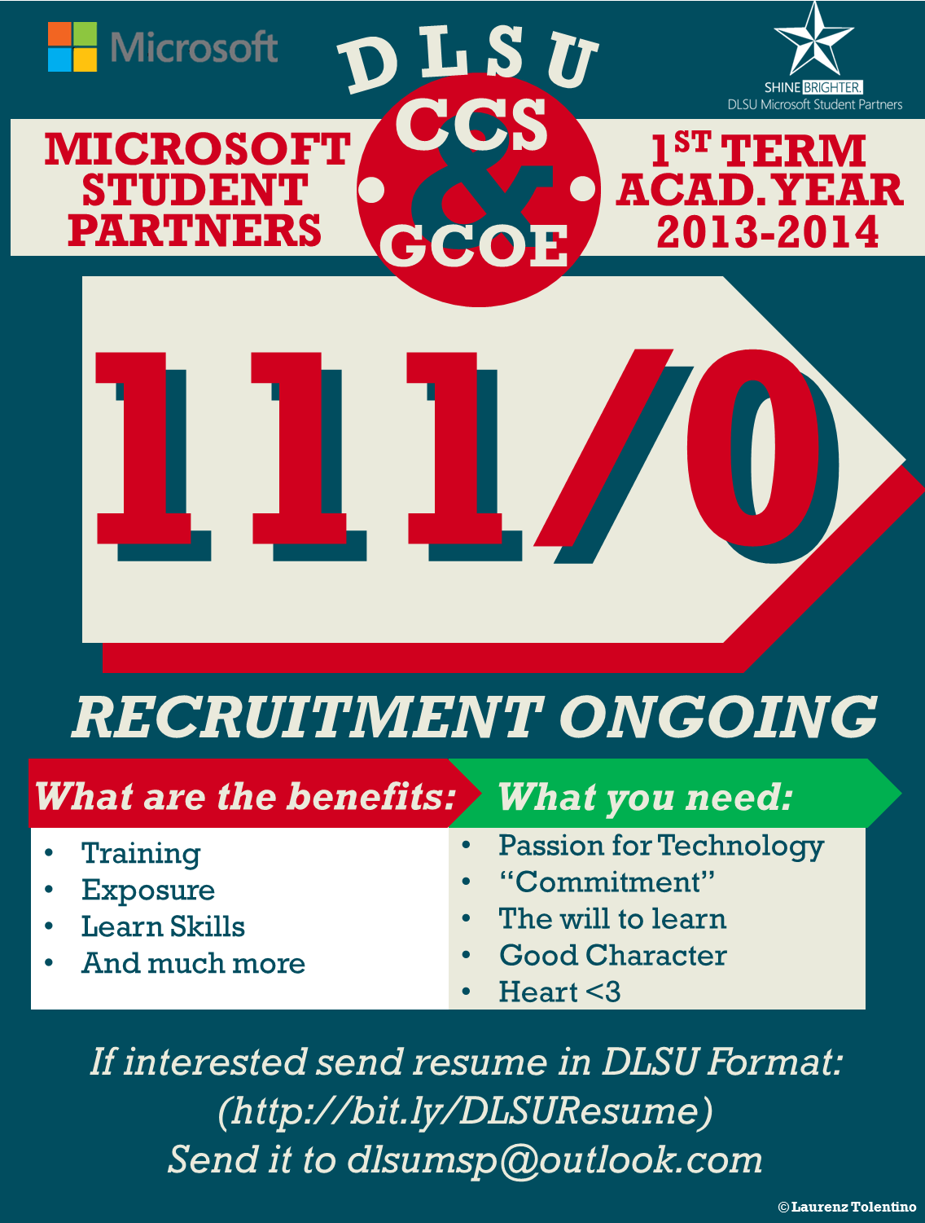
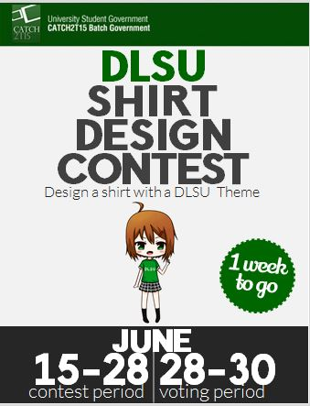
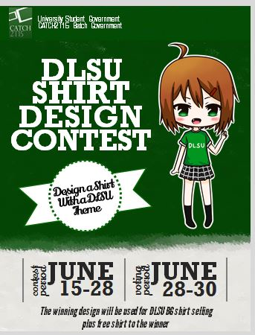

Slide 13
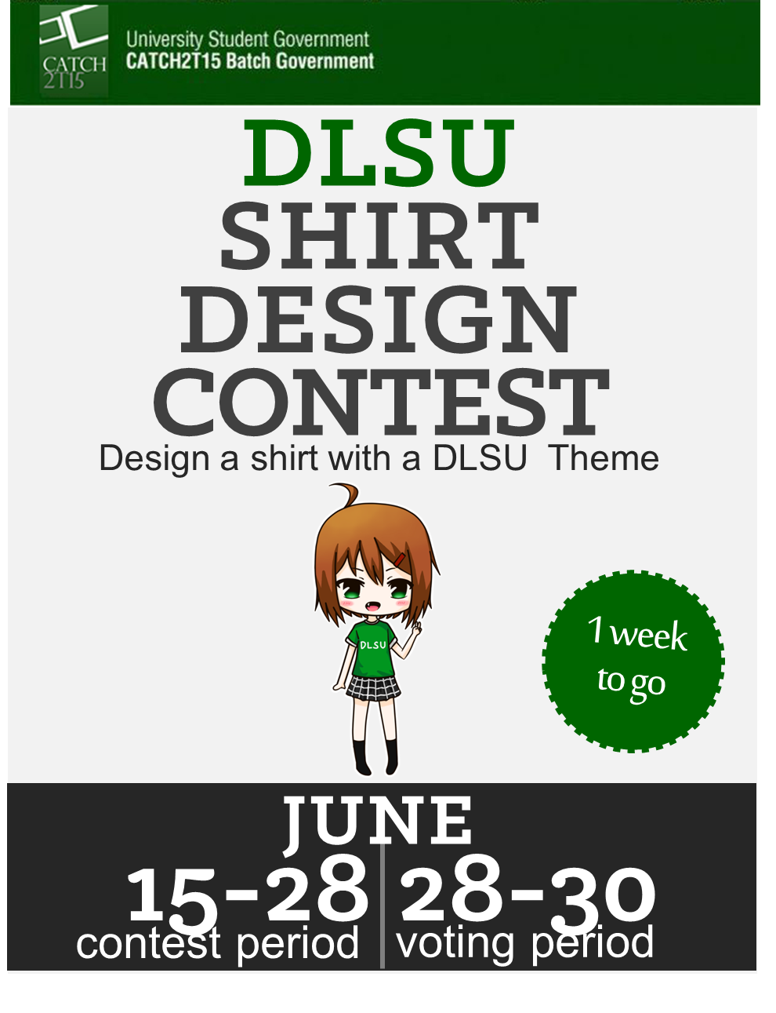
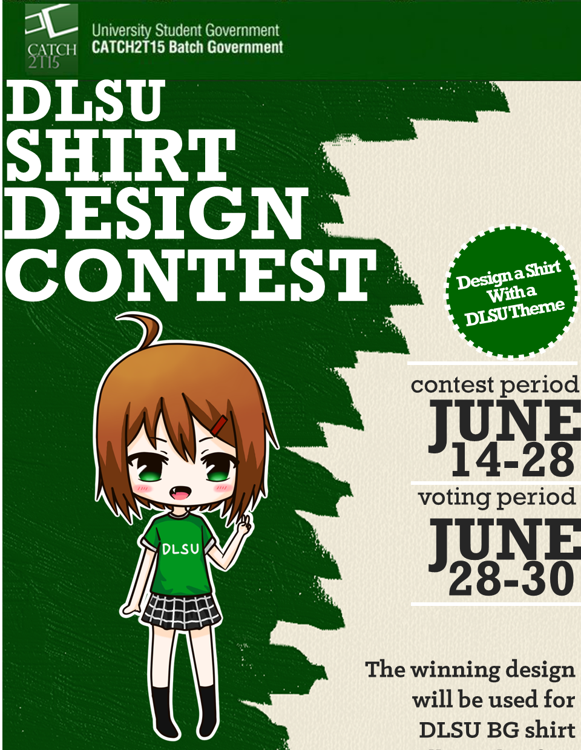
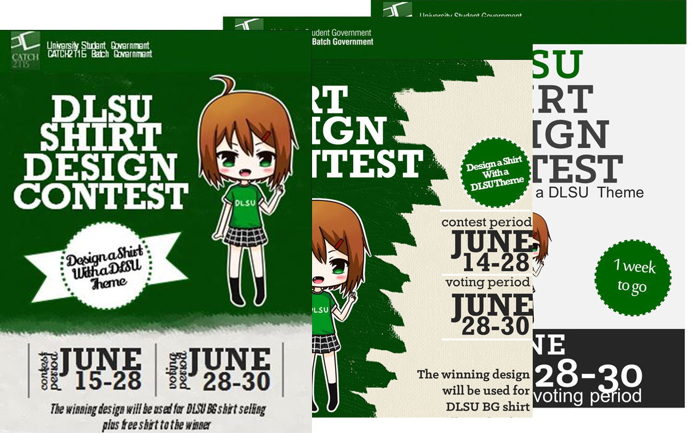

Slide 14



Slide 15
10%
LEVEL
10%
LEVEL
1
1
COMPLETION
NEXT
COMPLETION
NEXT
GOAL
GOAL
TRAIN
START
ABOUT
TIME
TIME
19
19

Slide 17
gamedes

Slide 18
Cover Photos

Slide 19
Bytes
&
Bits
LSCS Publications
Nina De Leon
Grab
a copy
when possible
Term 2, 2013-14
La salle
Computer
Society
Notes:
Diba banner siya, sa left side parangm ay collage ng mga healthy food (ikaw na bahala kung anong ilalagay mo). Then sa kanan nakalagay "HEALTHY GIVEAWAY Because you guys are awesome, we're giving away meals to 5 lucky people who signed up for MetroPlate! If you haven't done so, sign up at www.metroplate.ph now and have your food delivered to you on December 13!"

Slide 20

creative
Native
creative
Native
creative
Native
Notes:
Diba banner siya, sa left side parangm ay collage ng mga healthy food (ikaw na bahala kung anong ilalagay mo). Then sa kanan nakalagay "HEALTHY GIVEAWAY Because you guys are awesome, we're giving away meals to 5 lucky people who signed up for MetroPlate! If you haven't done so, sign up at www.metroplate.ph now and have your food delivered to you on December 13!"

